Slide 1
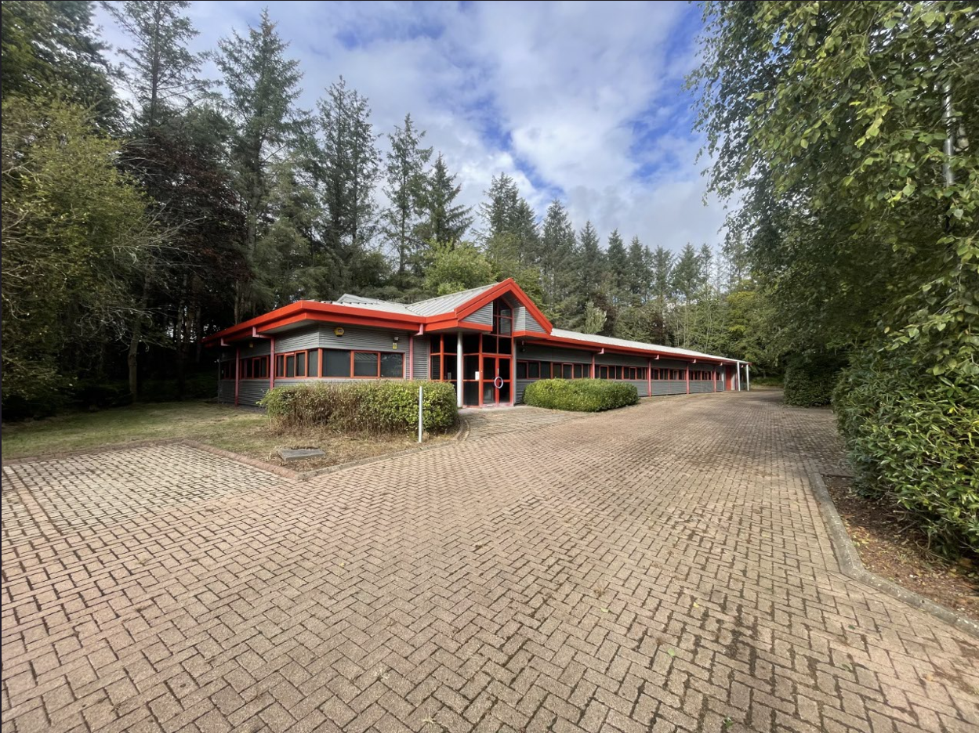
To let
Detached Office and Warehouse
Situated within Aberdeen Innovation Park
Potential to convert office space to additional warehouse accommodation
Unit 1b, campus 3, Aberdeen innovation park, Balgownie road, Aberdeen, ab22 8gw
CONTACT: Mark McQueen mark.mcqueen@shepherd.co.uk | 01224 202800 | shepherd.co.uk

Slide 2

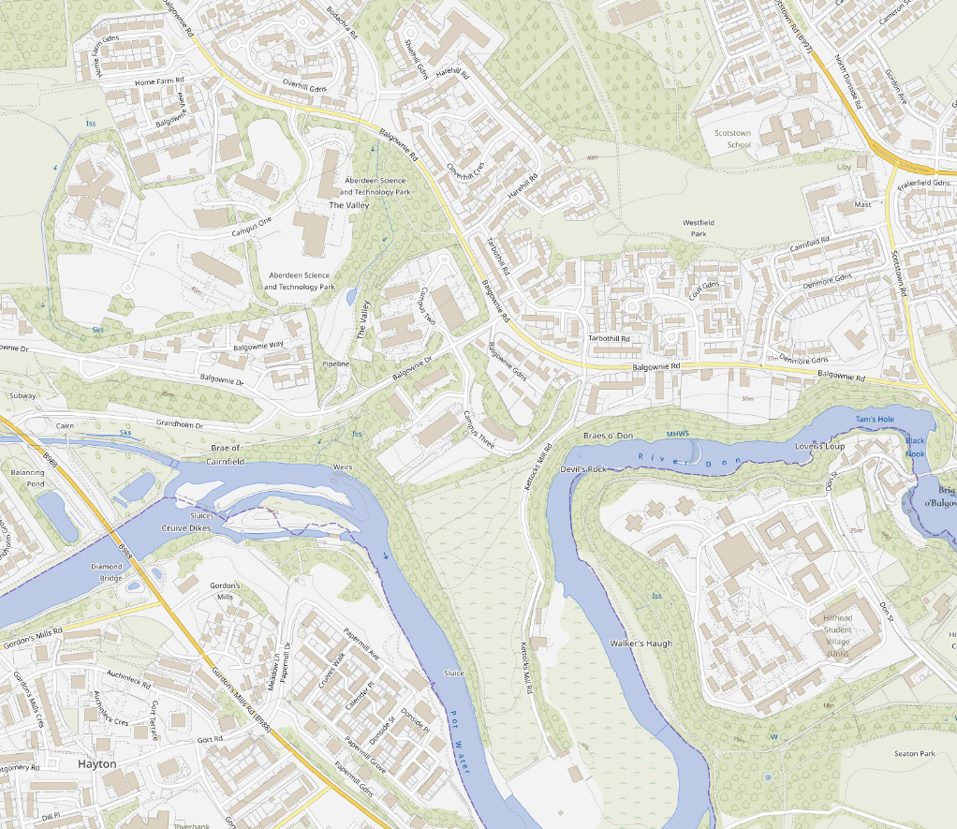


Location
UNIt 1b, campus 3, Aberdeen innovation park, Balgownie road, Aberdeen, ab22 8gw
The subjects are located to the North East periphery of Aberdeen City, in the Bridge of Don area. The Bridge of Don area comprises largely of commuter residential accommodation together with a number of established commercial locations.
More specifically the subjects form part of Campus 3 within the Aberdeen Science Park. This area is a popular and established commercial/office location to the periphery of Aberdeen within the Bridge of Don area. The Bridge of Don area is a highly residential location, however, located within close proximity to the unit a number of commercial occupiers can be found, including iXblue, Gyrodata and Stompers Childcare. The subjects can be accessed directly from Balgownie Drive and further benefit from being located in close proximity to the third don crossing and routes to the north.
Detached Office and Warehouse
FIND ON GOOGLE MAPS

Slide 3
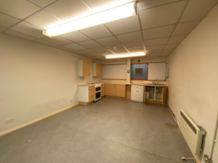
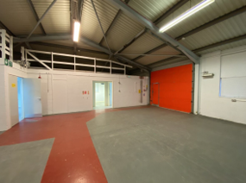
Description
UNIt 1b, campus 3, Aberdeen innovation park, Balgownie road, Aberdeen, ab22 8gw
The subjects comprise of a ground floor office and workshop facility of traditional concrete blockwork design. The roof over the subjects is pitched and is of steel panel design. Access to the property is via a pedestrian door of glazed design incased in aluminum. Further access to the property can be found via the vehicular roller shutter door at the opposite end of the subjects. ​
Internally, the subjects have been split to provide reception, office space, kitchenette, male and female W.C facilities, shower room and warehouse. Floors throughout the property are concrete and have been covered in carpet in the office areas. Linoleum has been used to decorate the kitchen and toilets and in the workshop the floor is of a painted design. Walls are a mixture of painted concrete blockwork and plastered and painted stud partitioned walls with ceilings of a suspended timber design. Natural daylight is provided via a number of double glazed windows which have been encased in aluminum, whilst artificial lighting is provided via fluorescent strip light fitments throughout. ​
To the front projection of the property there is a sizeable carpark.
​ | m²​ | ft²​
​Office | 497 | 5,348
Warehouse | 148 | 1,594
TOTAL​ | 645 | 6,942
The above floor areas have been calculated on a Net Internal Floor Area basis in accordance with the RICS Code of Measuring Practice (6th Edition).

Slide 4






The Detail
UNIt 1b, campus 3, Aberdeen innovation park, Balgownie road, Aberdeen, ab22 8gw
Rental
Offers in excess of £50,000 per annum exclusive of VAT are sought.
Lease Terms
Our clients are seeking to lease the subjects for medium to long term. Any medium to long term lease lengths will incorporate upward only rent reviews.
Rateable Value
The subjects are currently entered into the Valuation Roll as a workshop at a Rateable Value of £47,750.
An ingoing occupier will have the ability to appeal this figure.
Energy Performance Certificate
The subjects have a current Energy Performance Rating of G.
Further information and a recommendation report are available to seriously interested parties on request.
VAT
All figures quoted are exclusive of VAT at the prevailing rate.
Legal Costs
Each party shall be responsible for their own legal costs associated with this transactions with the tenant being responsible for the cost of LBTT and Registration Dues.
Get in Touch
For further information or viewing arrangements please contact the
sole agents:
Mark McQueen
mark.mcqueen@shepherd.co.uk
Shepherd Chartered Surveyors
35 Queens Road, Aberdeen, AB15 4ZN
t: 01224 202800
ANTI MONEY LAUNDERING REGULATIONS
The Money Laundering, Terrorist Financing and Transfer of Funds (Information on the Payer) Regulations 2017 came into force on the 26th June 2017. This now requires us to conduct due diligence not only on our client but also on any purchasers or occupiers. Once an offer has been accepted, the prospective purchaser(s)/occupier(s) will need to provide, as a minimum, proof of identity and residence and proof of funds for the purchase, before the transaction can proceed.
shepherd.co.uk
J & E Shepherd for themselves and for the vendors or lessors of this property whose agents they are, give notice that: (i) the particulars and plan are set out as a general outline for the guidance of intending purchasers or lessees, and do not constitute, nor constitute part of, an offer or contract (ii) all descriptions, dimensions, references to condition and necessary permissions for use and occupation, and other details are given in good faith and are believed to be correct at the date of first issue but any intending purchasers or tenants should not rely on them as statements or representations of fact but must satisfy themselves by inspection or otherwise as to the correctness of each of them; (iii) no person in the employment of J & E Shepherd has any authority to make or give any representation or warranty whatever in relation to this property; (iv) all prices and rentals are quoted exclusive of VAT unless otherwise stated. Prospective purchasers/lessees must satisfy themselves independently as to the incidence of VAT in respect of any transaction. PUBLICATION DATE JANUARY 2025 (UPDATED OCTOBER 2025).

